Slide 1
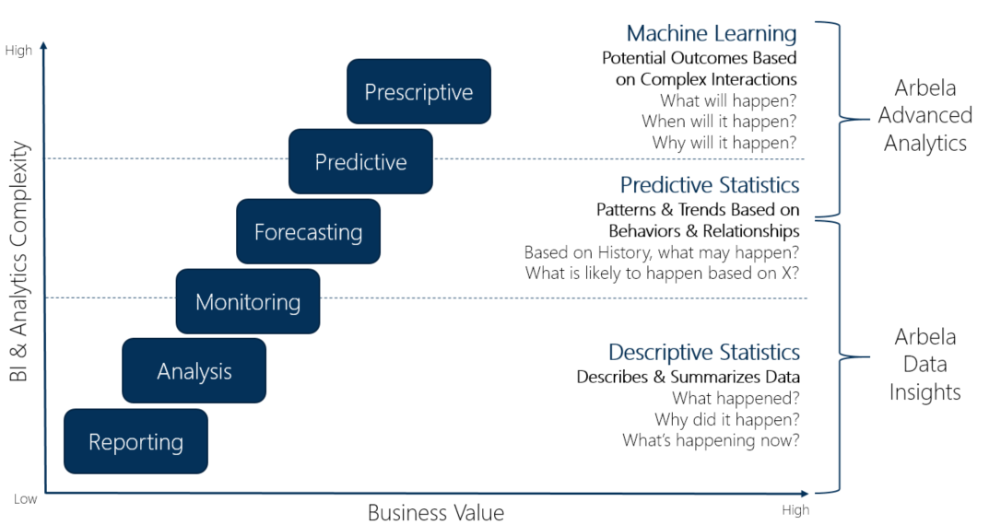
Information Utilization: Where are We?
Capability Progression
Functional but Antiquated Capability
The Information ‘Escalator’
Source: Argano (https://microsoft.argano.com/technologies/dynamics-extensions/argano-data-insights/)

Slide 2
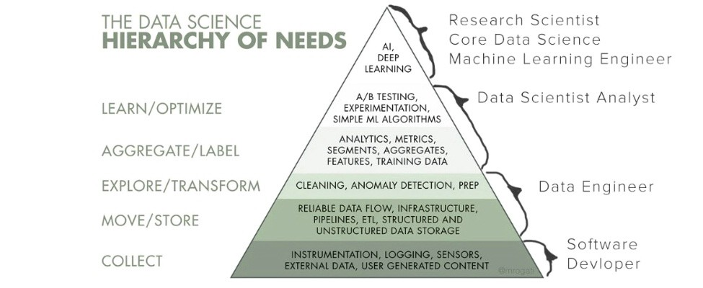
Data Infrastructure Demands
Organizations must build the infrastructure to implement (and reap the benefits of) the most basic data science algorithms and operations, much less machine learning.
Monica Rogatti, 2017

Slide 3

Infrastructure to Capability Relationship
Increase in organizational information capabilities can only occur when a threshold level of infrastructure is achieved and functioning
Advanced Analyst/ Statistician
Business Intelligence Analysts
Business Intelligence Analysts
Data Request Personnel
Threshold Level of Infrastructure

